Slide 1

EMAILS USING AI

Slide 2
In Gmail, you can use Gemini to draft emails based on your prompts.
You can use the Help me write button in Gmail

Slide 3
STEPS TO FOLLOW
On your computer, open Gmail.
At the top left, click Compose.
You can also reply to an email thread.
At the bottom left of the window, click Help me write
Enter a prompt. For example:
“A thank you letter for my job interview”
“A birthday invitation for my 5-year-old”
“Ask my friend for restaurant recommendations in Toronto”
Click Create.

Slide 5
(OPTIONAL )
After generating your draft, click:
Recreate: Generate a new draft based on your prompt. After you create a new version of the draft, you can’t go back to the previous version.
Refine: Revise the text in the draft.
Formalize: Make the draft more formal.
Elaborate: Add additional details to the draft.
Shorten: Shorten the draft.
If your draft looks good, click Insert

Slide 6
REFINE A DRAFT USING GEMINI IN GMAIL
At the top left, click Compose.
You can also reply to an email thread or open an existing draft.
Write your message.
At the bottom left of the window, click Help me write (Labs)
Choose an option from the menu:
Polish: Refine your draft.
Formalize: Make the draft more formal.
Elaborate: Add additional details to the draft.
Shorten: Shorten the draft.

Slide 8
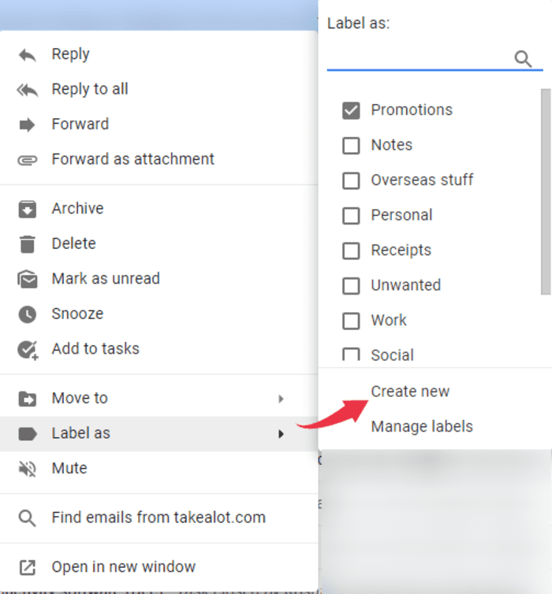
HOW TO ORGANIZE EMAILS
Emails can get messy, so it's good to stay organized:
Folders:
You can create folders to keep your emails sorted. For example, you can have a folder called "School" for school-related emails or "Work" for job emails.

Slide 9
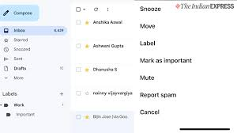
Archiving:
If you don’t want to delete an email but want it out of your inbox, you can archive it. It’s like putting it in storage, but you can find it later.
Mark as Important:
You can mark important emails so that they stand out. This helps you remember to read or reply to them later.

Slide 10

EMAIL ETIQUETTE
Be Polite:
Just like you would say “Hello” or “Thank you” in a letter, use polite words in your emails. Always say “Hi” at the beginning and “Thank you” at the end.
Check Your Spelling and Grammar:
Before sending, read through your email to make sure everything makes sense and there are no mistakes.

Slide 11
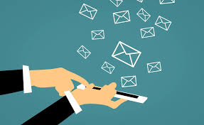
Use Clear Subjects:
The subject of your email should tell the person what the email is about, so they know if it’s urgent or if they can read it later.
Don’t Write in All Caps:
Writing in ALL CAPS can seem like you’re shouting. It’s better to use normal sentences.

